Slide 1
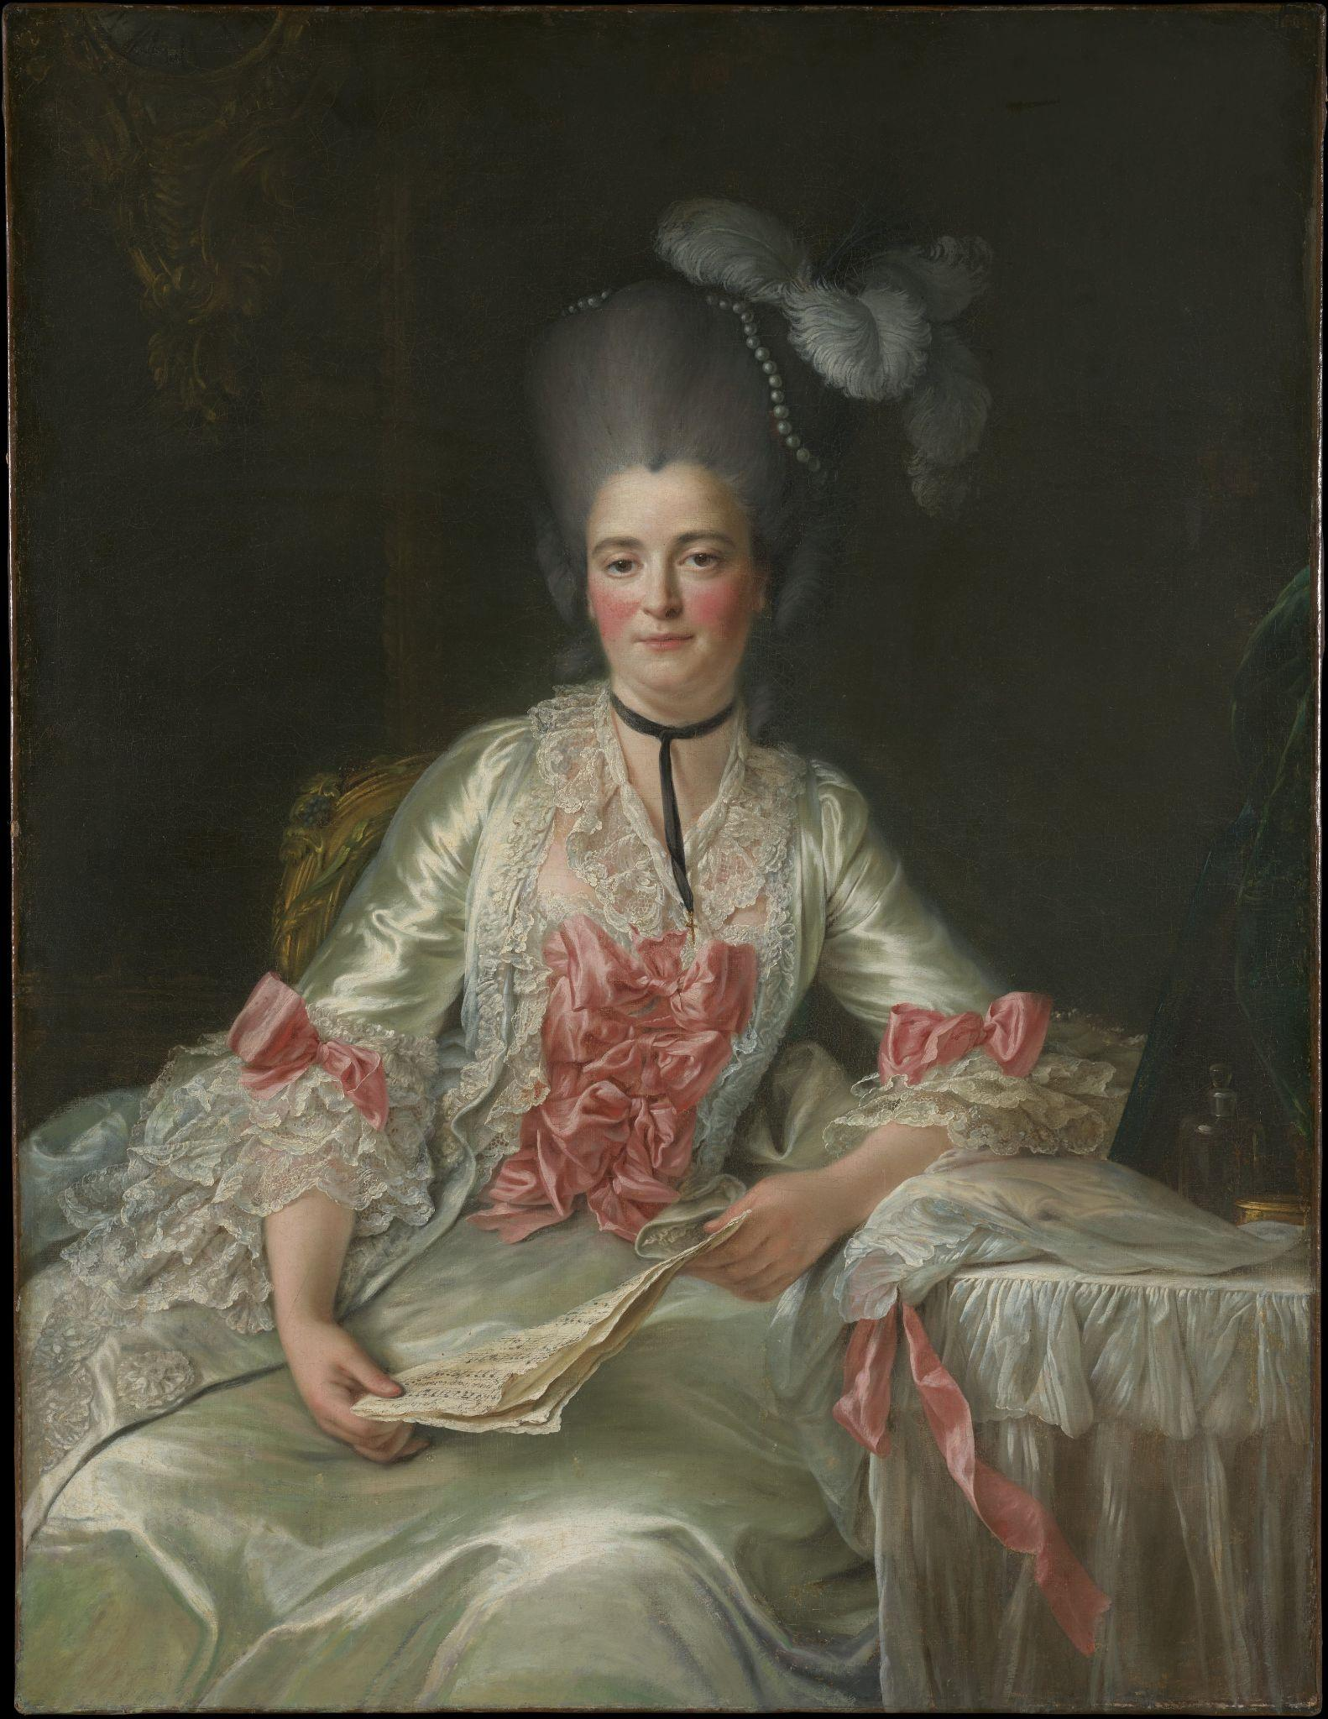

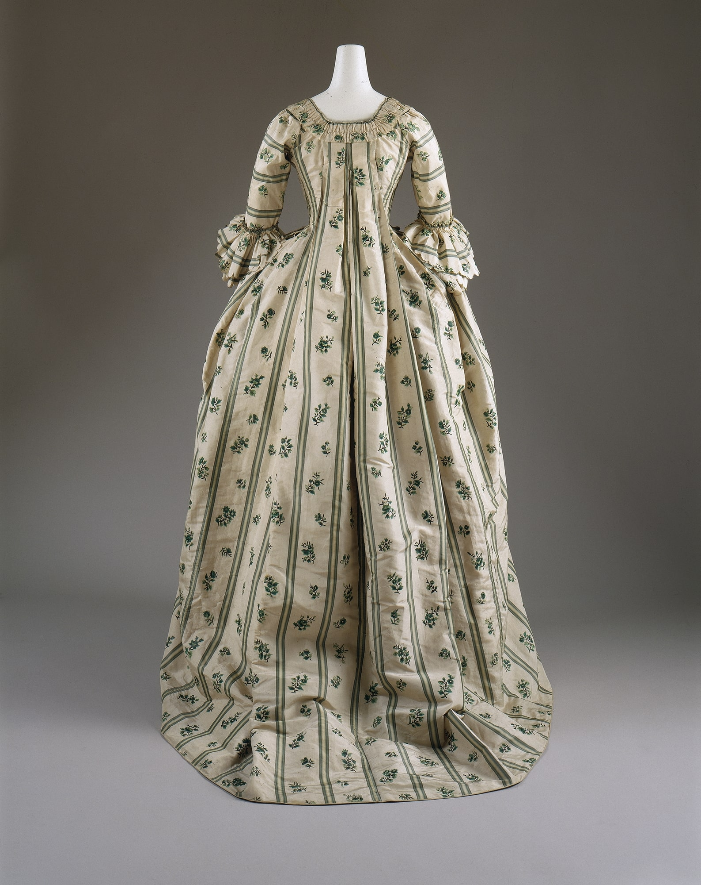

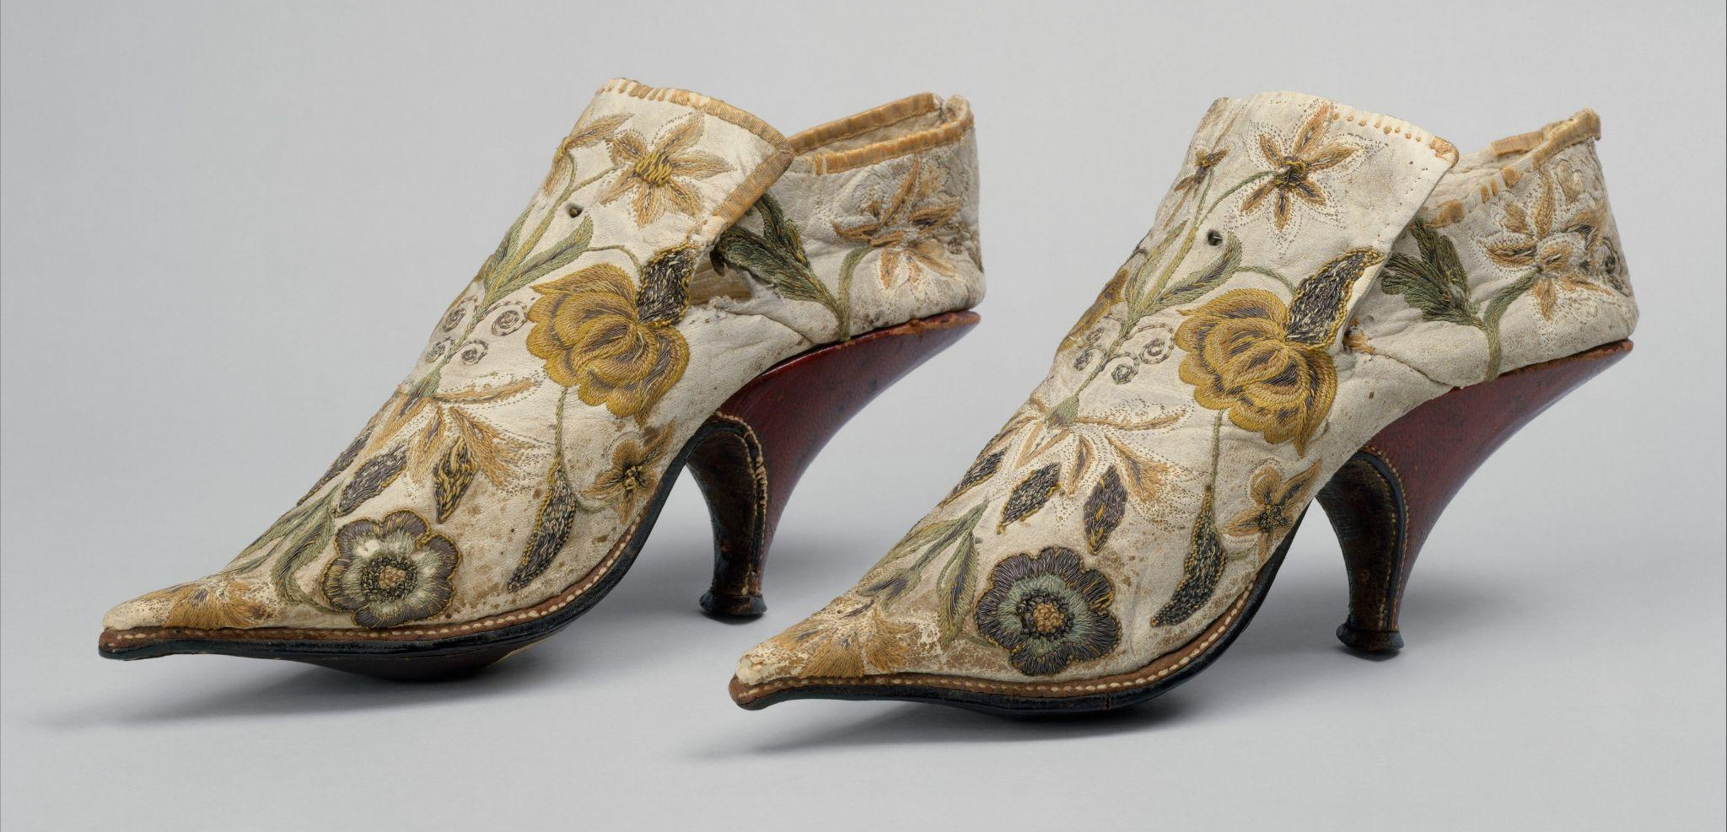
INDIVIDUALS AND SOCIETIES
Roles innovation and technology play in the development of Empires
Wednesday, 24 September, 2025
By: Richael, Remi, Calvin and Jeremie.

Slide 2

01
02
Table of contents
03
04
INTRODUCTION
CONTENT
What is an innovation?
What is technology?
How do Innovations and Technologies impact the development of an empire?
CONTEXT
CONCLUSION
Examples throughout history of how empires were impacted.
Activities and questions to test your knowledge.

Slide 3
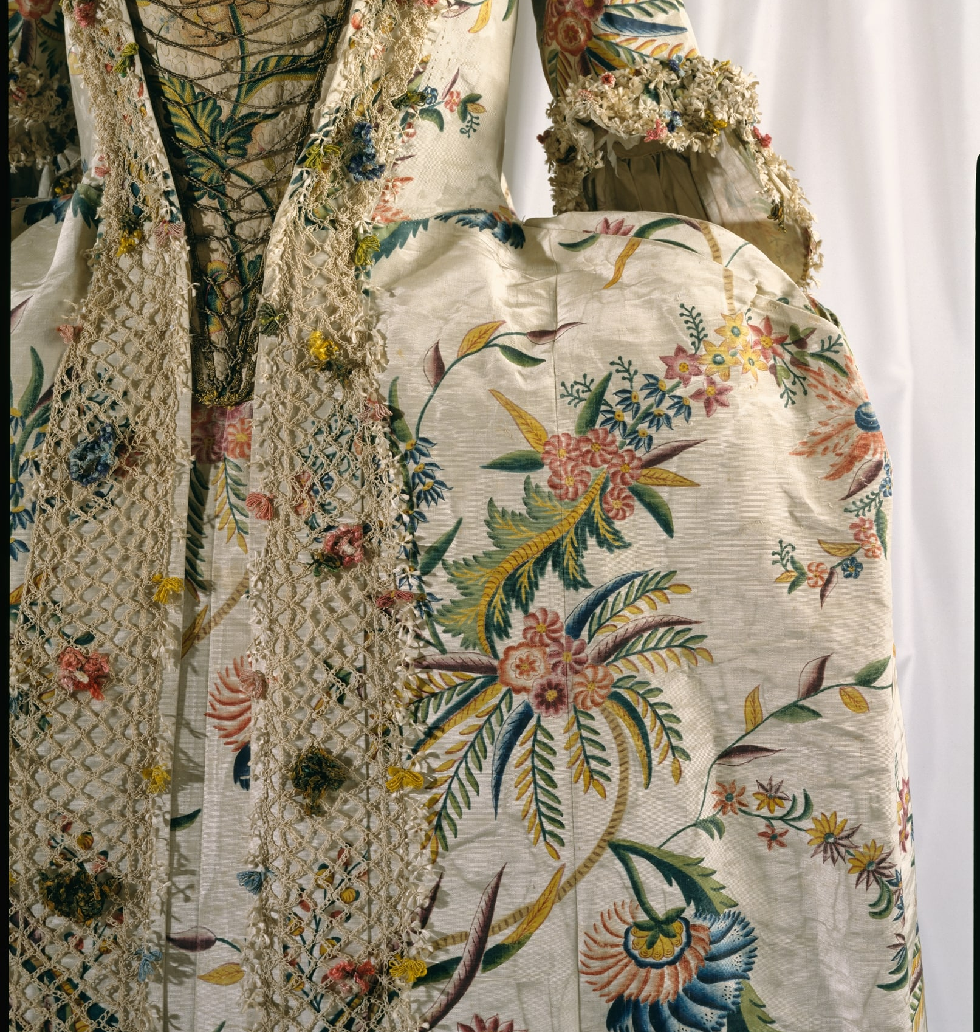
01
Definition of Innovation and Technology
An innovation is the process of developing and implementing new or significantly improved ideas, products, services, or processes that create value
Technology is the application of scientific knowledge for practical purposes, especially in industry.

Slide 4
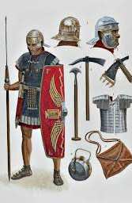
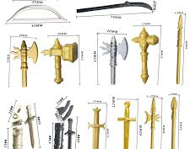
Chapter 2 - Content
How do Innovations and Technologies impact the development of an empire?

Slide 5
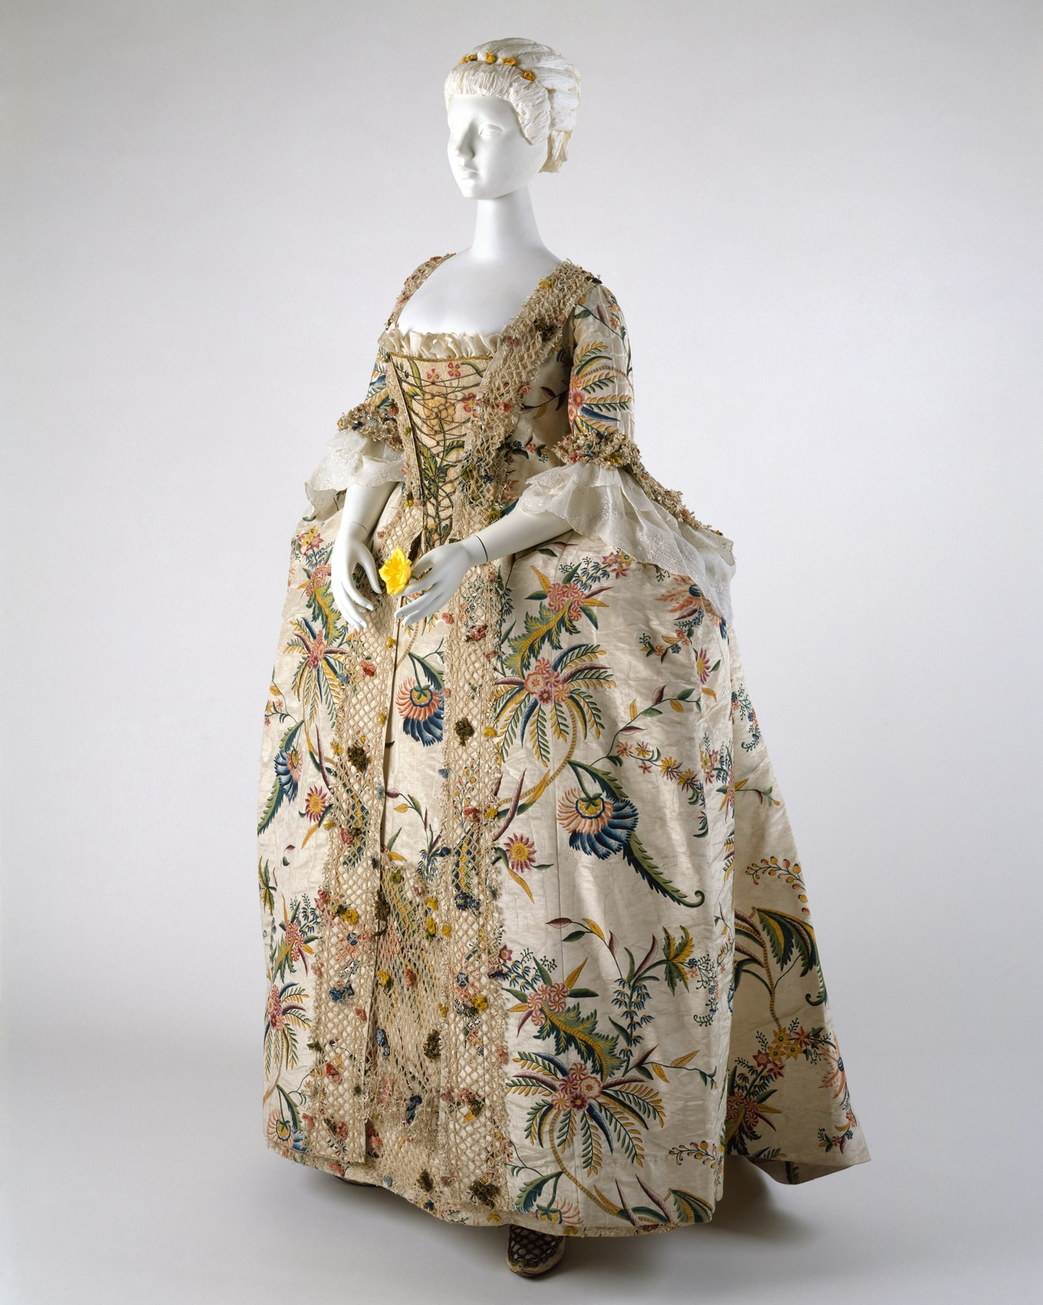
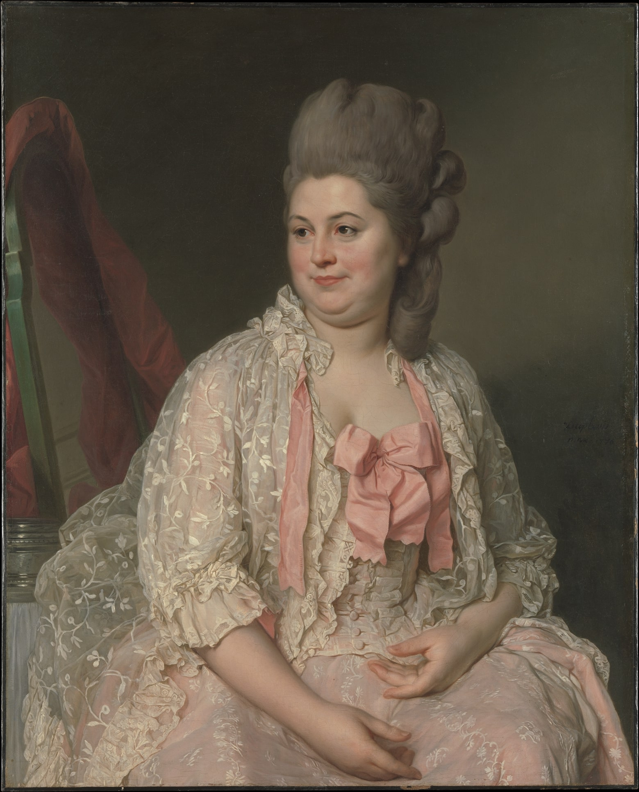

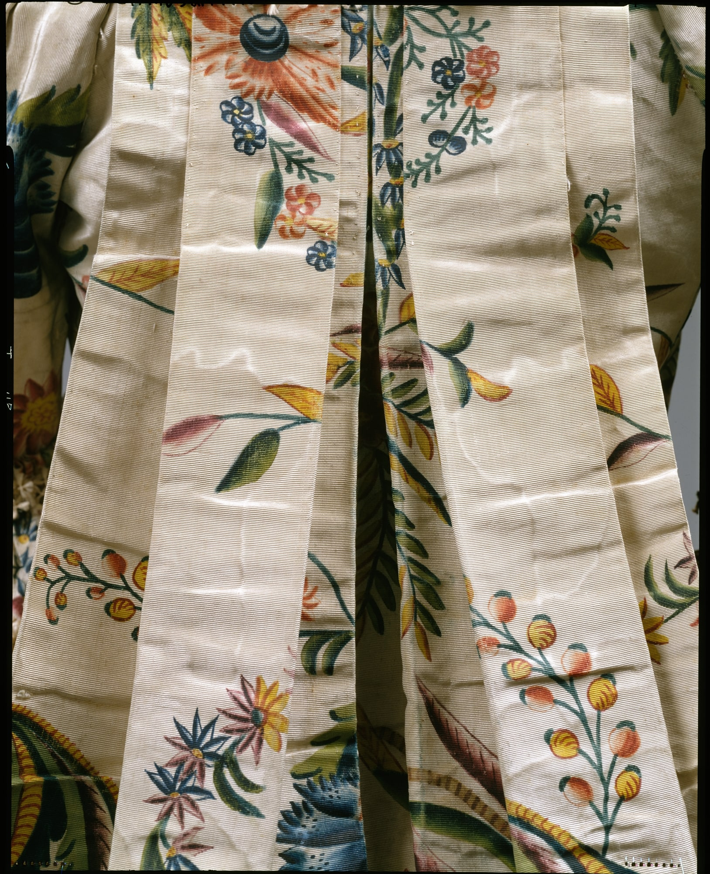
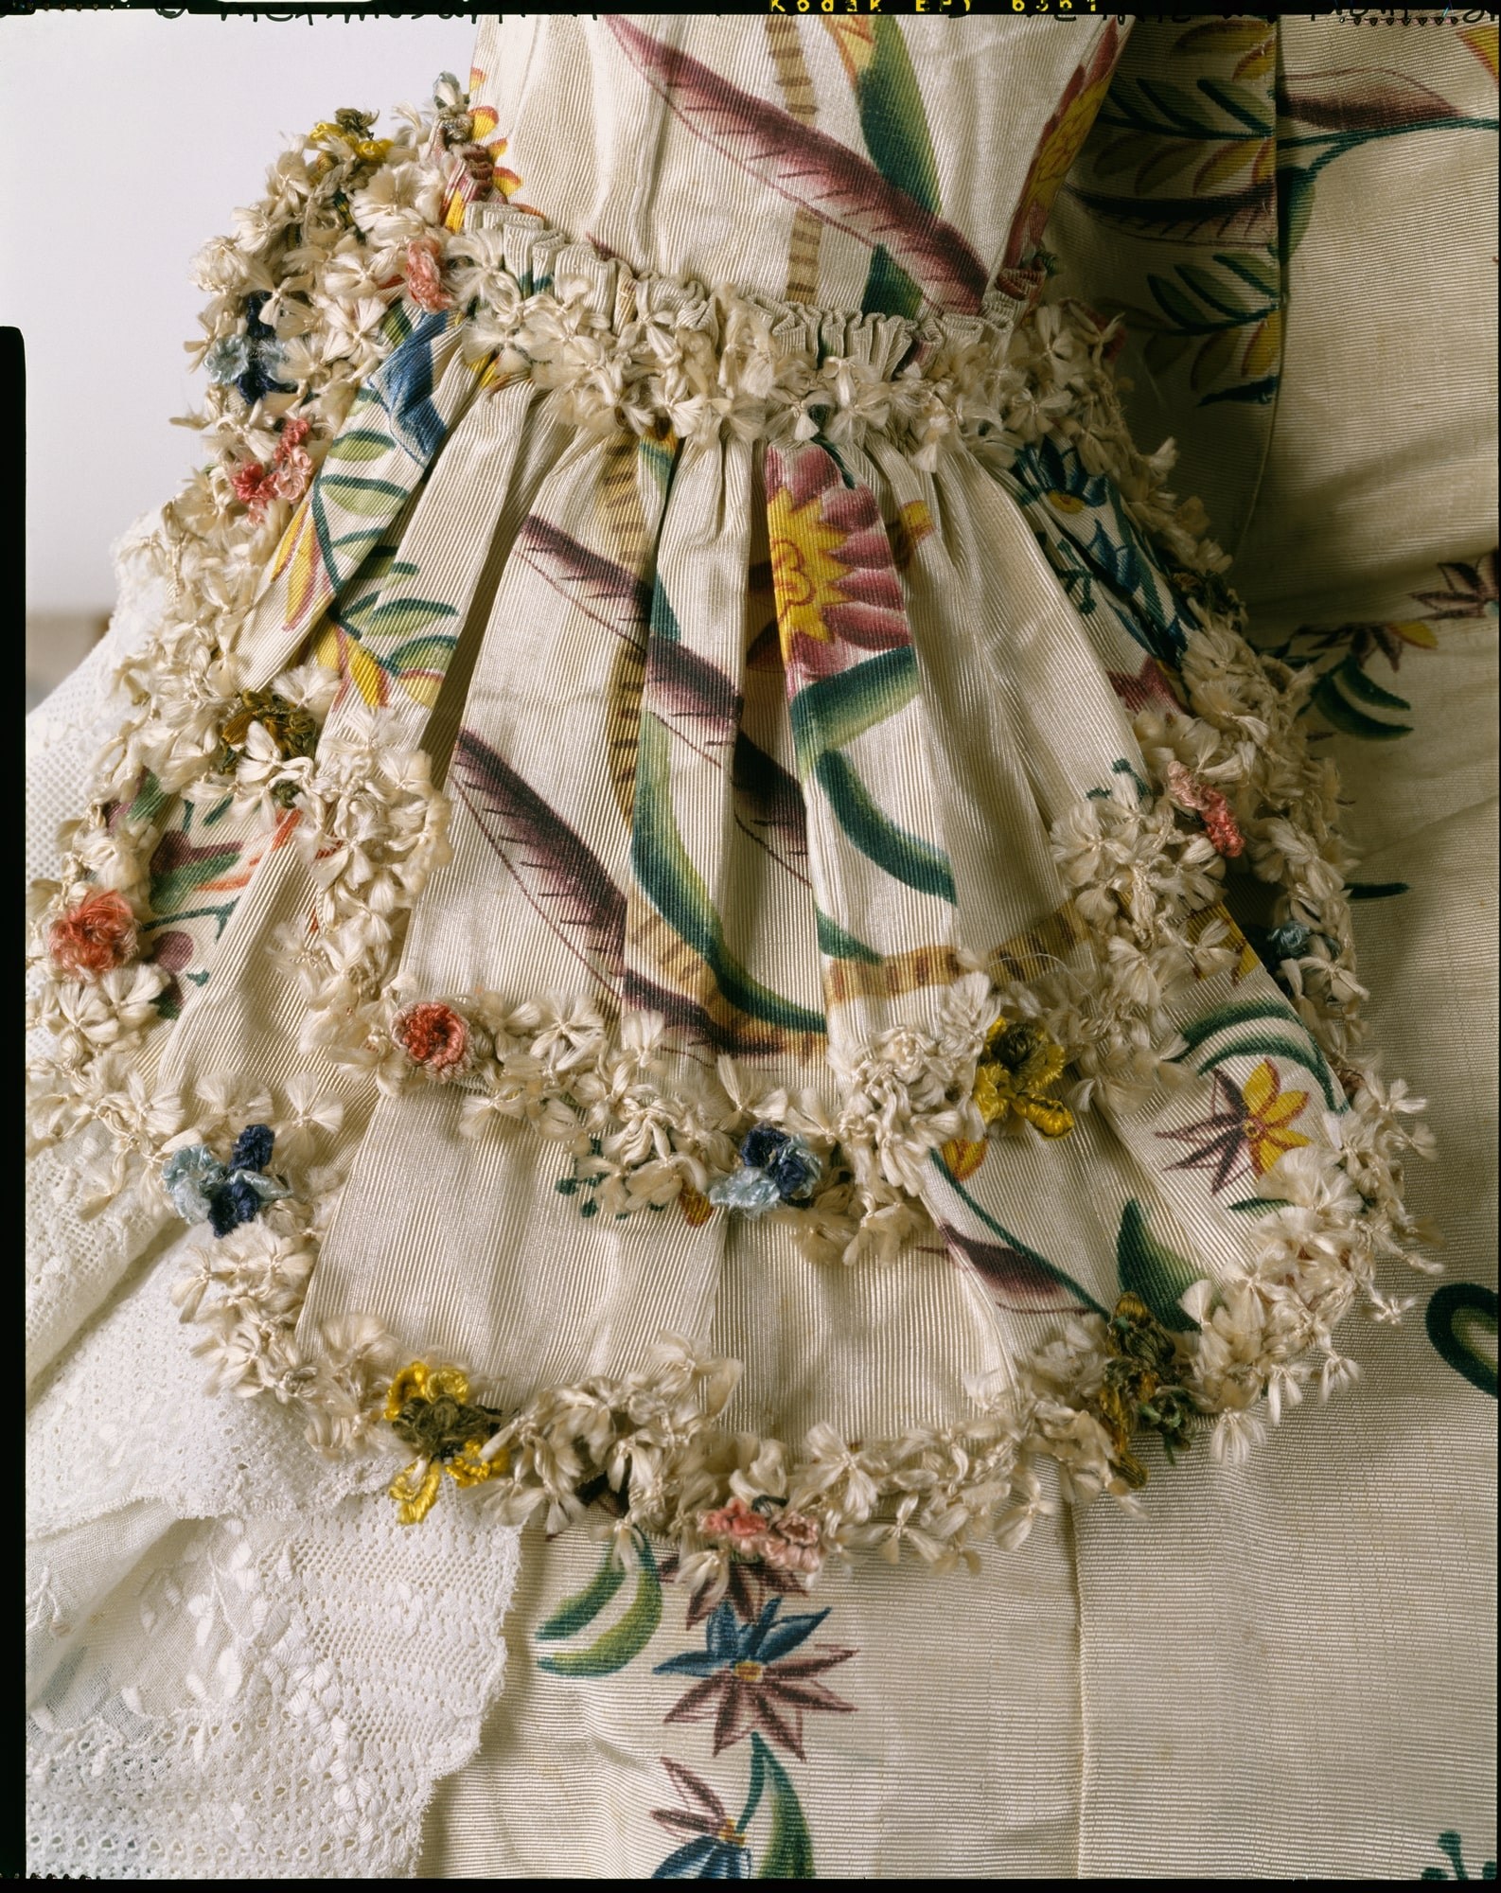
How Innovation and Technology affect empire development?
Innovation and technology are at the heart of empire development, shaping their rise, expansion, and legacy.
Innovation and technology are both key tools used and needed in empire development, in order to make a strong and self sufficient empire.

Slide 6
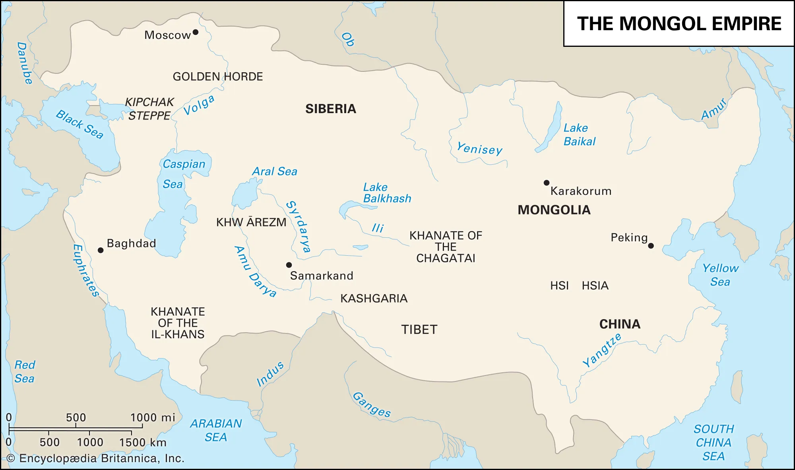
1. Military Power
Innovation and technology were central to the military strength of empires. Superior weapons, armor, and tactics often determined which
empire could expand and which would fall.
For instance, the Mongols used advanced composite bows, stirrups, and horse-riding techniques to build one of the largest land empires in history.
Gunpowder changed the balance of power in the early modern era, as cannons and muskets allowed empires like the Ottomans and Europeans to break through fortified cities.

Slide 7
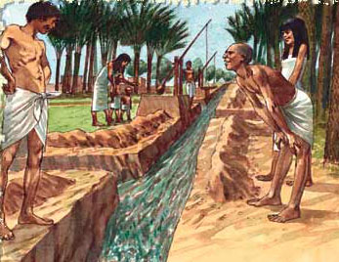
2. Economic Growth
Technological innovations in agriculture and trade fueled economic prosperity that sustained empires. With wealth from farming and commerce, empires could fund armies, build infrastructure, and encourage further innovation, strengthening their ability to expand and maintain power.
Irrigation systems in Mesopotamia and terraced farming in the Inca Empire supported food production for large populations.
Standardized coinage and navigation tools allowed trade networks like the Silk Road to flourish, enriching empires such as Rome and Han China.

Slide 8
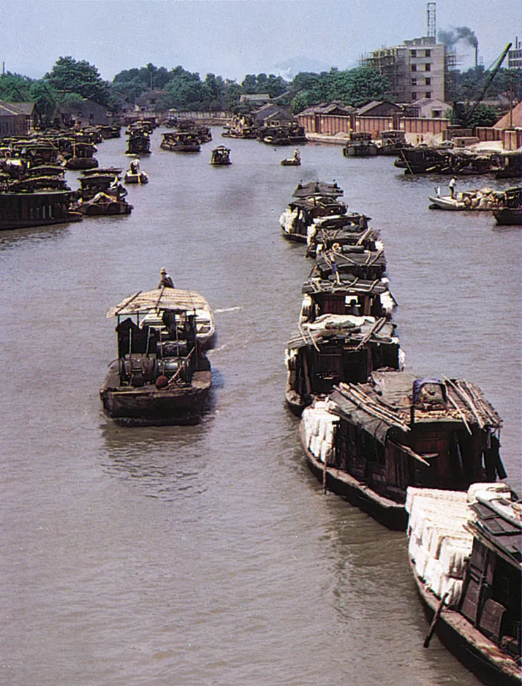
3. Infrastructure and Expansion
Infrastructure innovations allowed empires to expand and stay connected.
Roman roads and aqueducts supported troop movement and urban growth.
China’s Grand Canal linked regions for trade and administration.
Strong infrastructure not only boosted economic activity but also tied distant areas together under one political system. These projects symbolized imperial power while ensuring resources, people, and armies could be mobilized quickly to maintain stability.

Slide 9
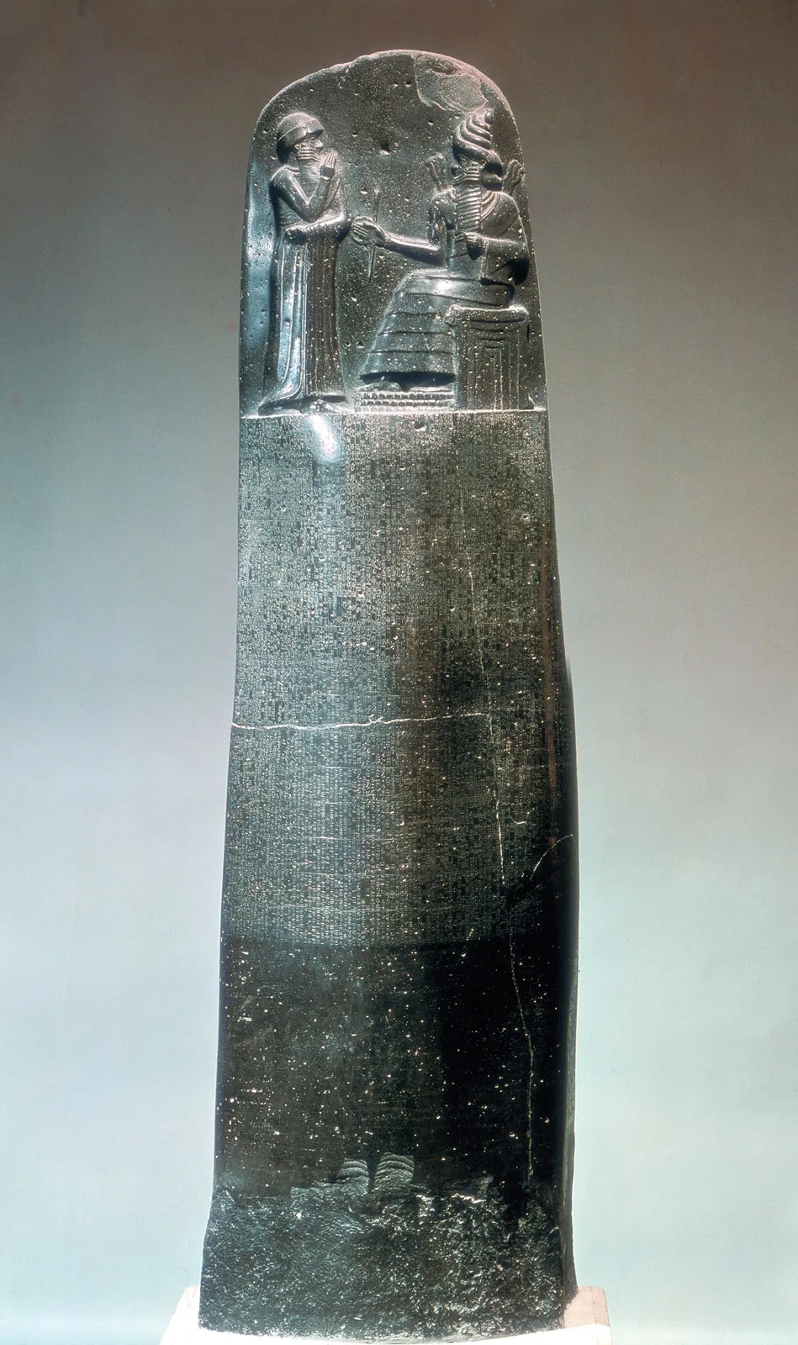
4. Communication and Administration
Efficient administration relied on technological advances in communication. Writing systems allowed laws and taxes to be recorded.
Hammurabi’s Code in Babylon.
The Persian Royal Road and Roman postal systems connected distant provinces.
In China, paper and woodblock printing improved bureaucracy by spreading information across vast territories.
These tools helped rulers govern diverse populations, prevent unrest, and maintain stability, making communication technology one of the foundations of long-lasting imperial control.

Slide 10
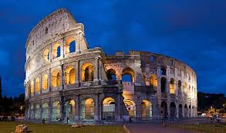
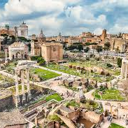
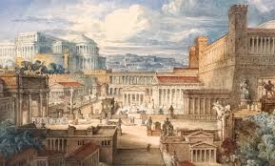
03 Context
Some examples of empires that have been majorly affect from innovation and technologies would be??
1)The chinese Empires( Hang, Ton, Song, and Ming)
2)The Roman Empire
3)The Islamic Calipahtes.

Slide 11
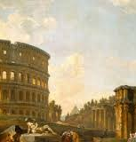
How they were affected and what it changed
CHINA-
Innovation- Paper, Printing, Gun powder.
Technology- Great walls, and Canals
ROME-
Innovation- Aqueducts, Legal systems and Road systems.
Technology- Advanced Military weapons.
ISLAMIC CALIPHATES-
Innovation-Algebra Medicine and Building Universities.
Technology- Surgical tools, Observatories

Slide 12
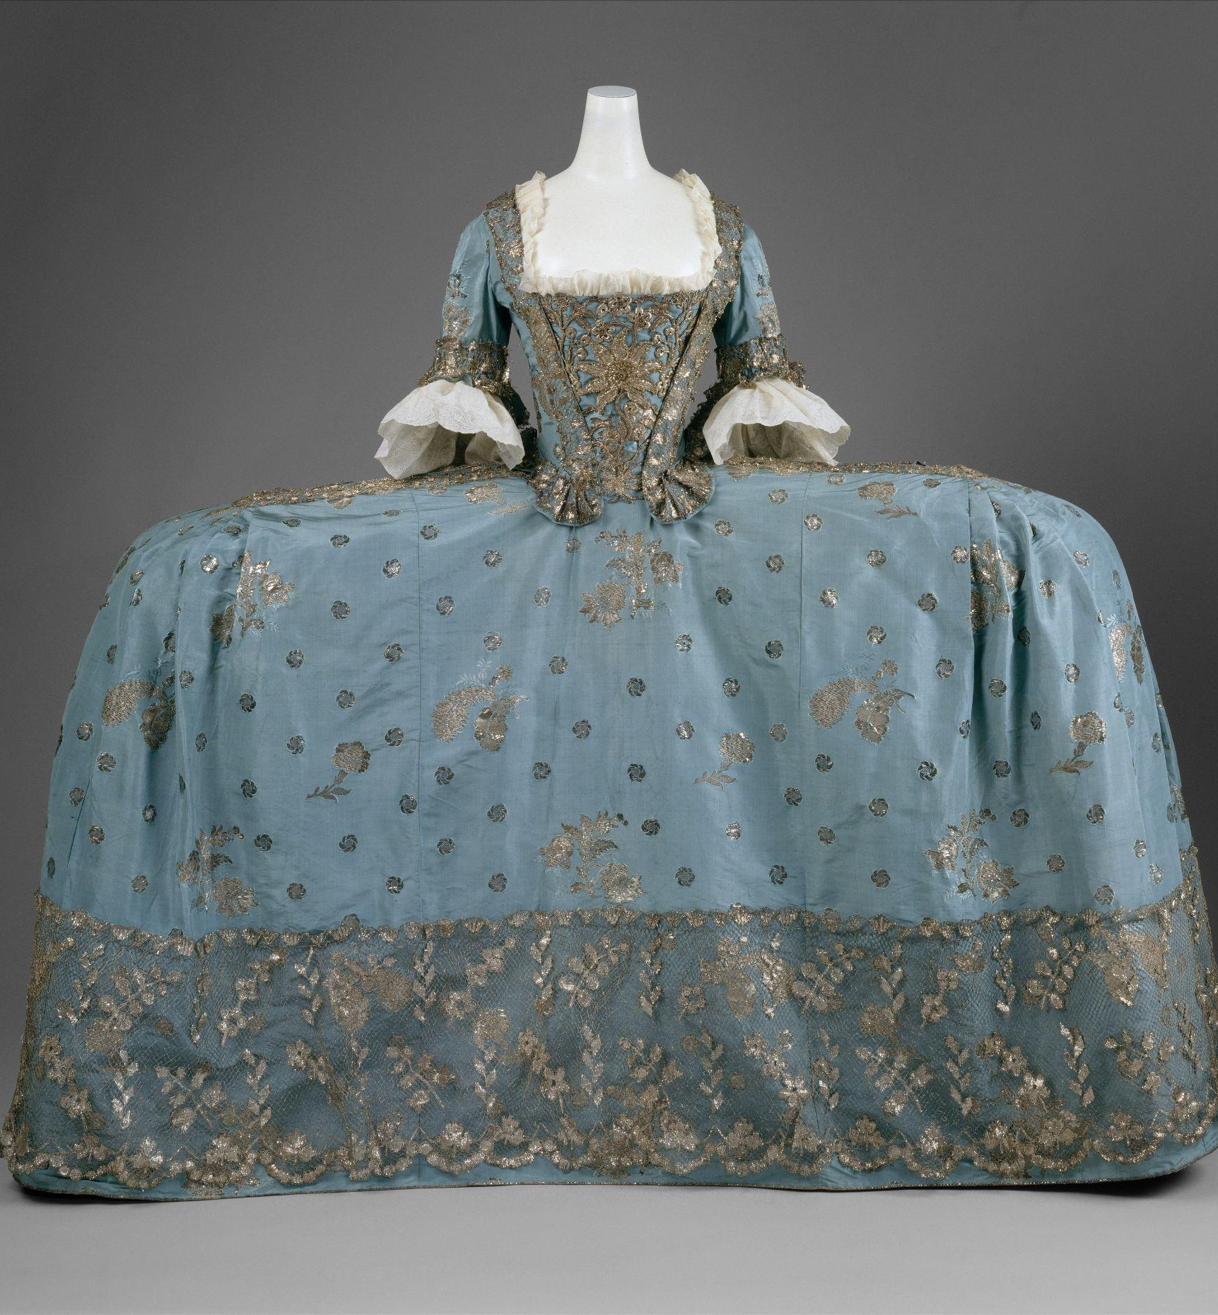
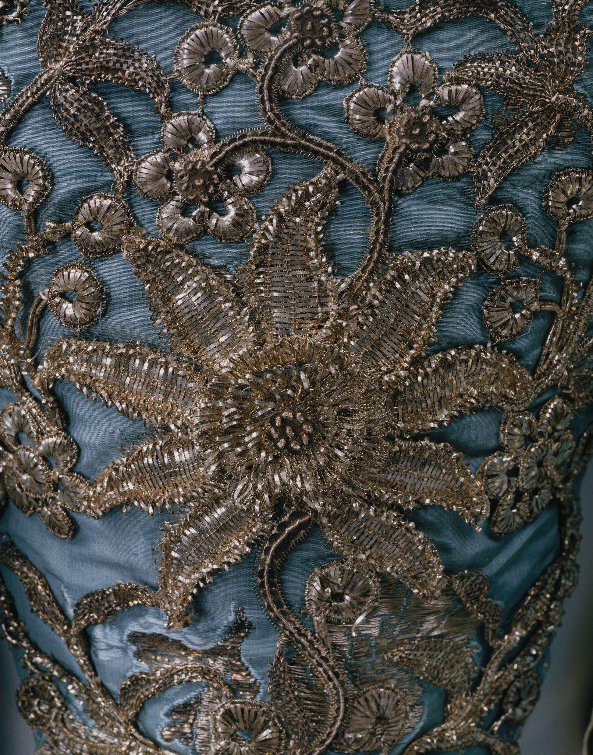


04
ACTIVITY TIME!!
Instruction will be shared

Slide 13
04 (Questions)
1)What is an Innovation
2)Name 1 examples of a technology invented by China
3)What is an aqueduct
4)How does infrastructure and expansion affect an empire according to out slides
5)How do communication and administration affect an empire according to our slides

Slide 14
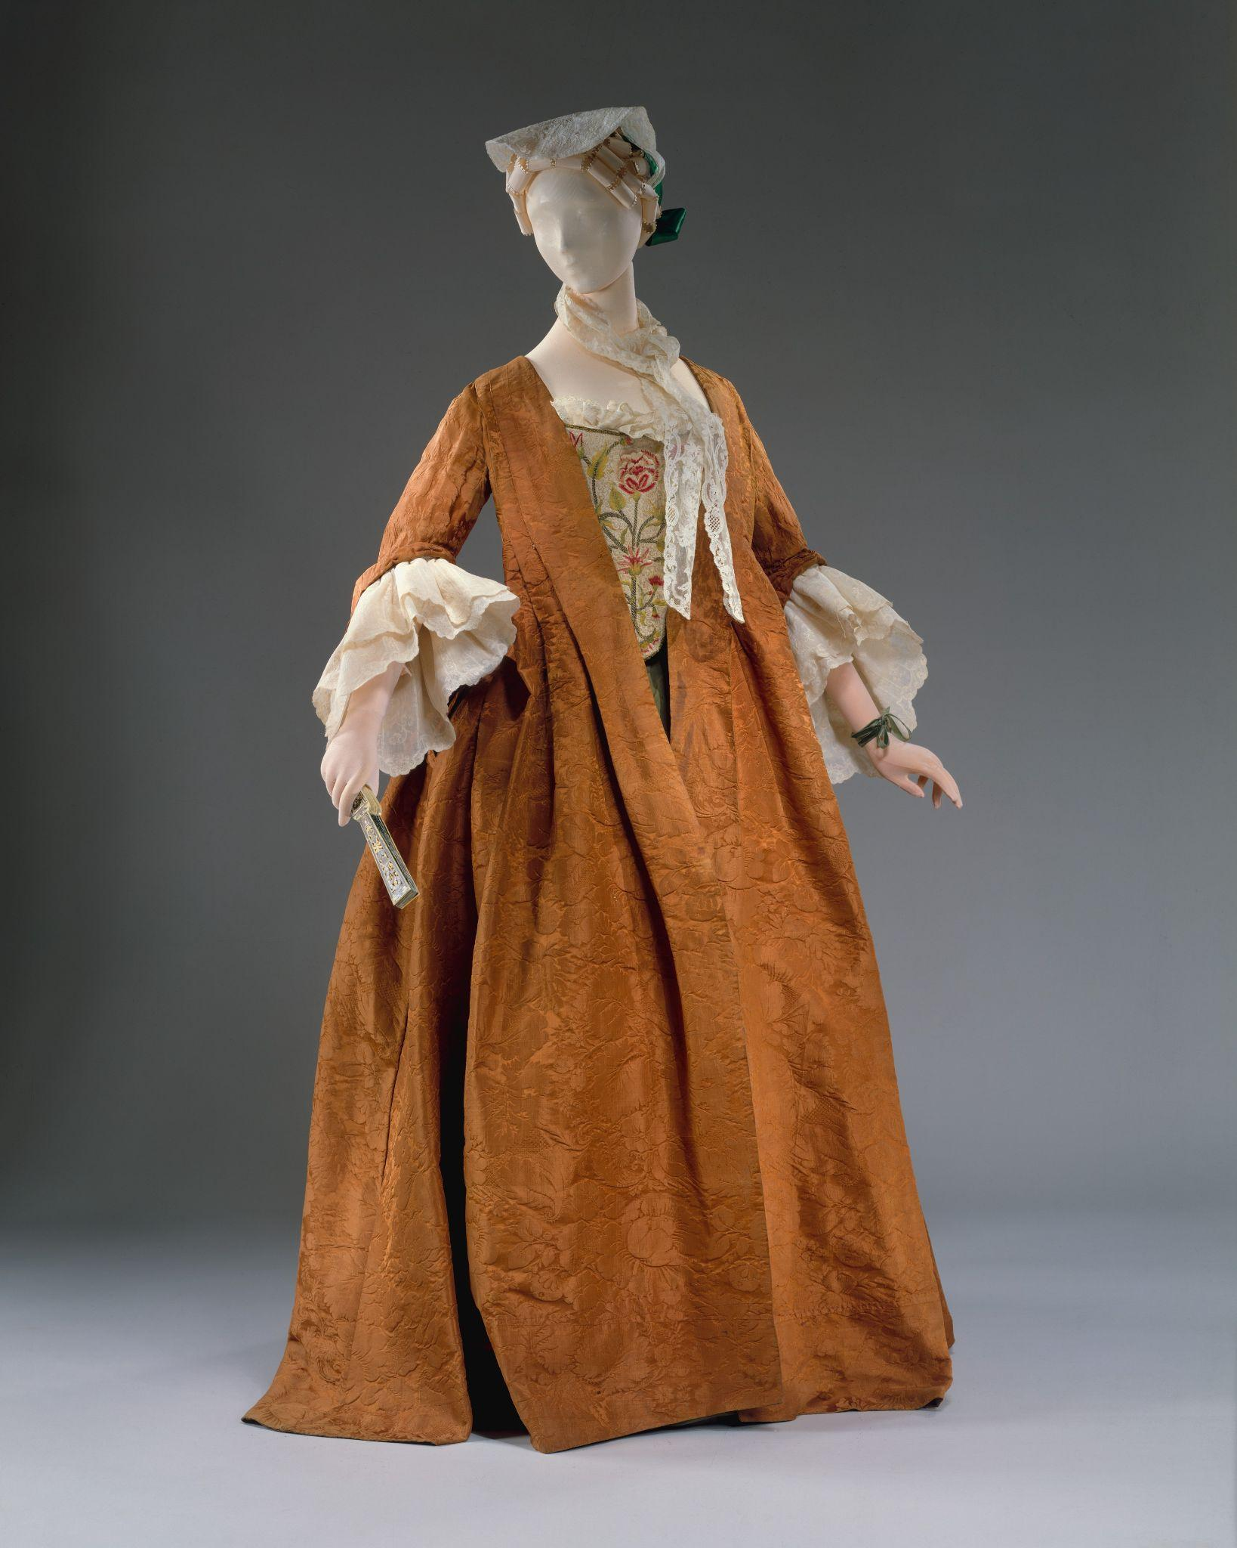
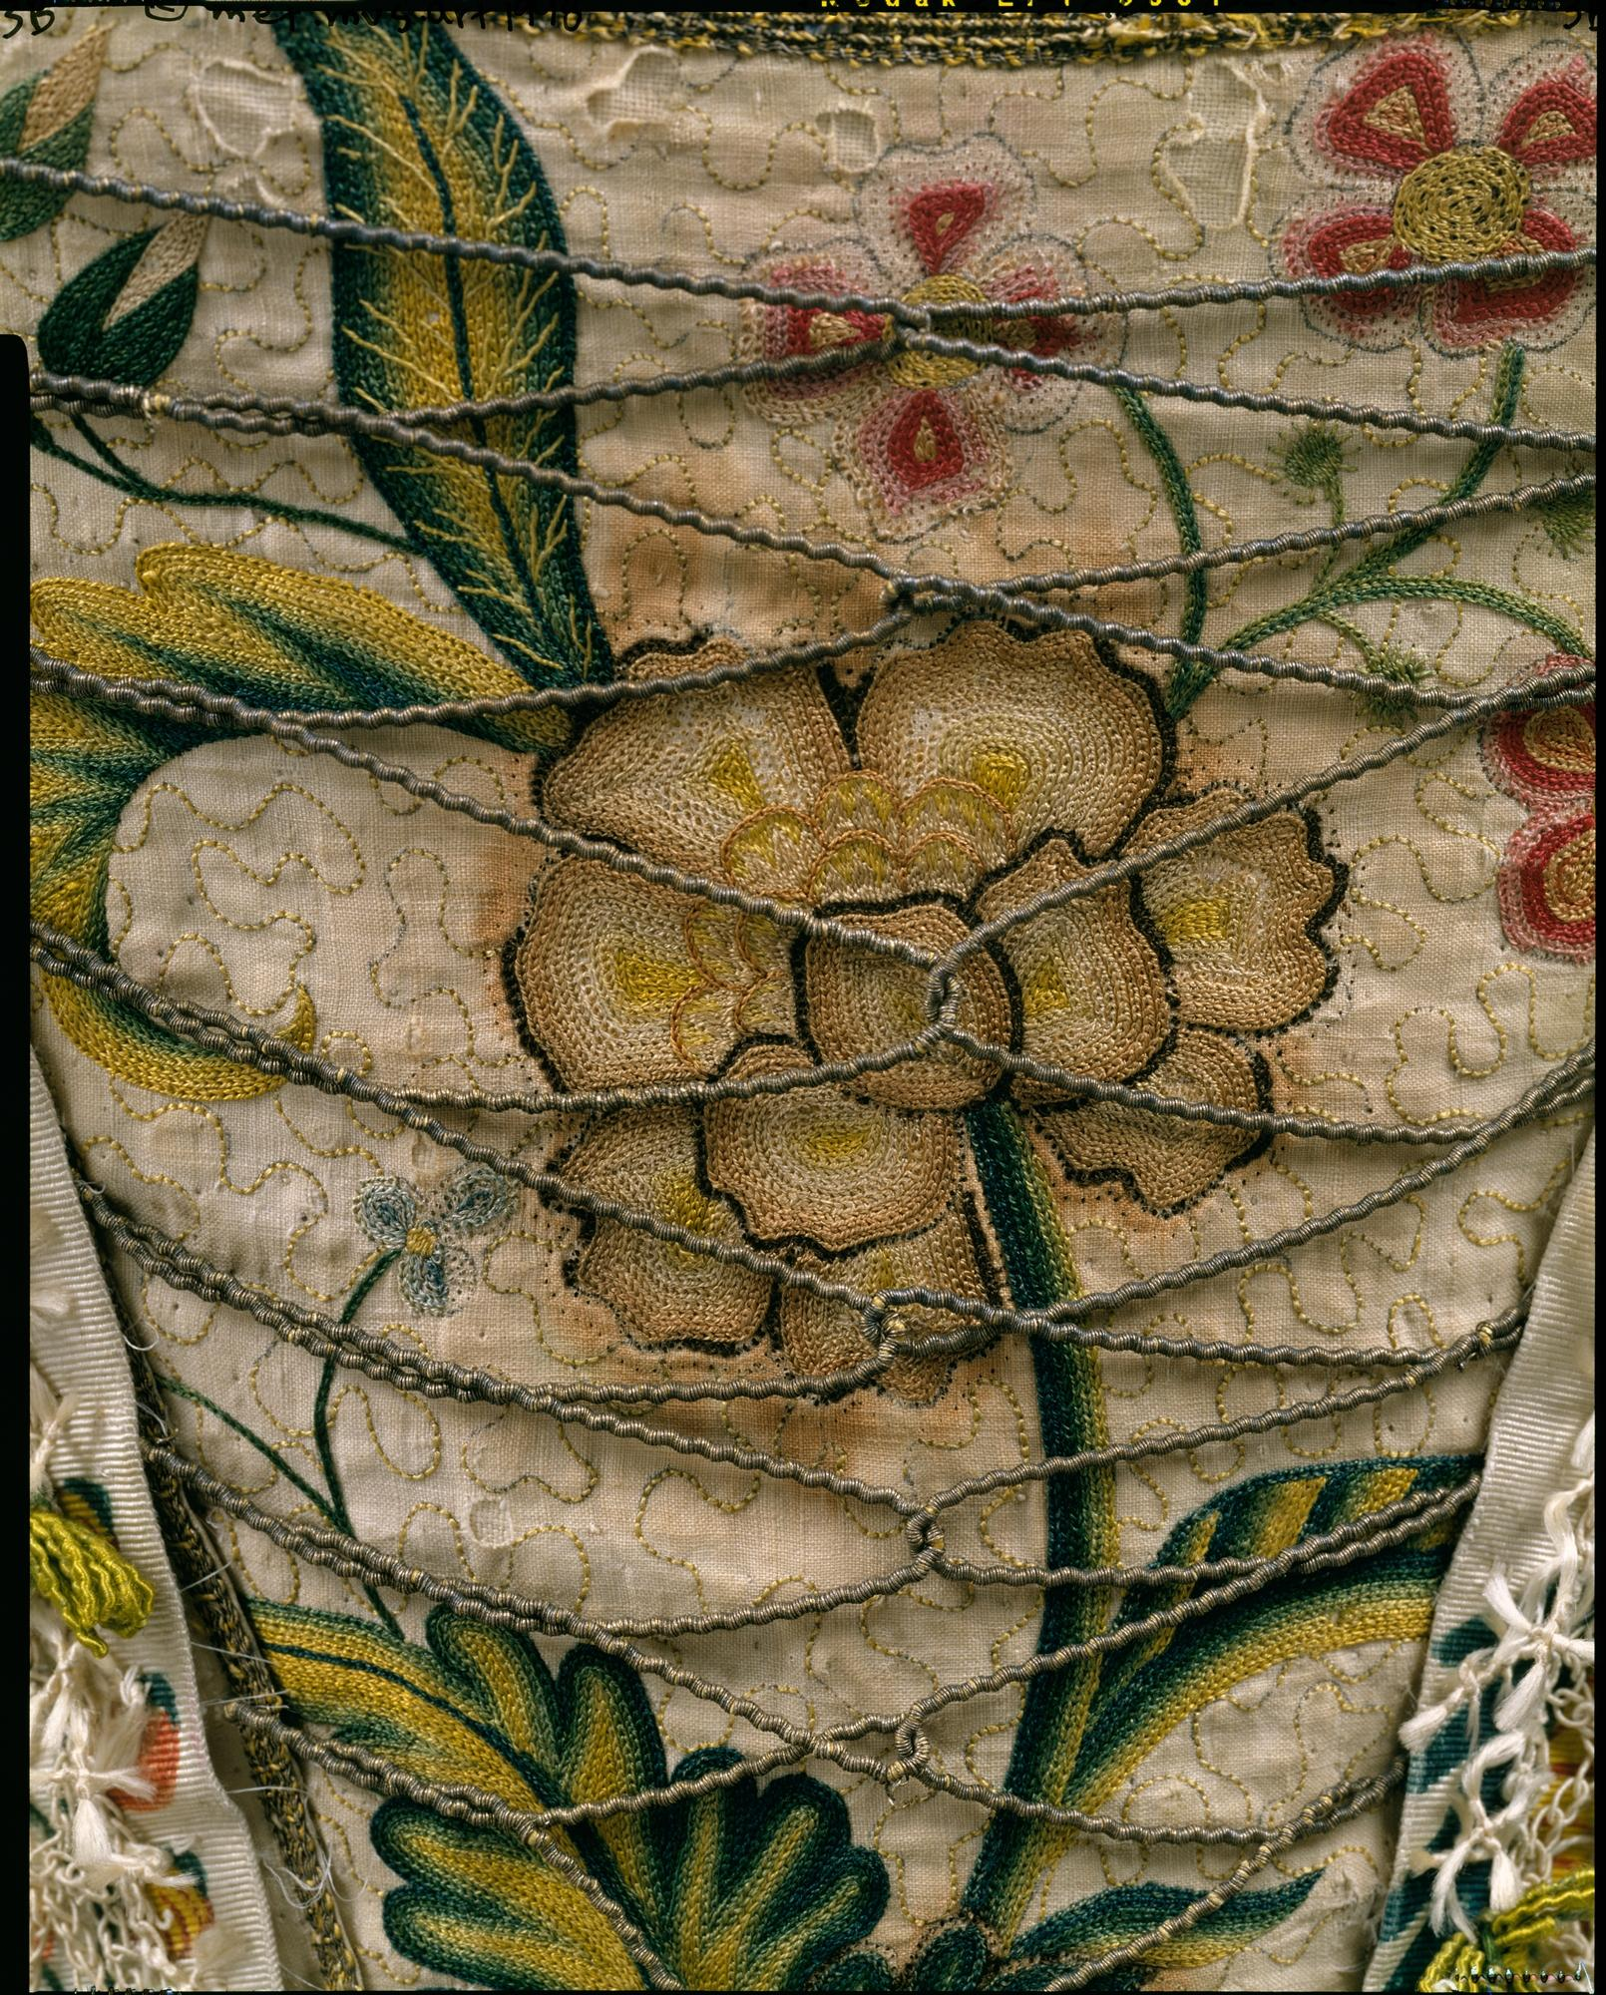

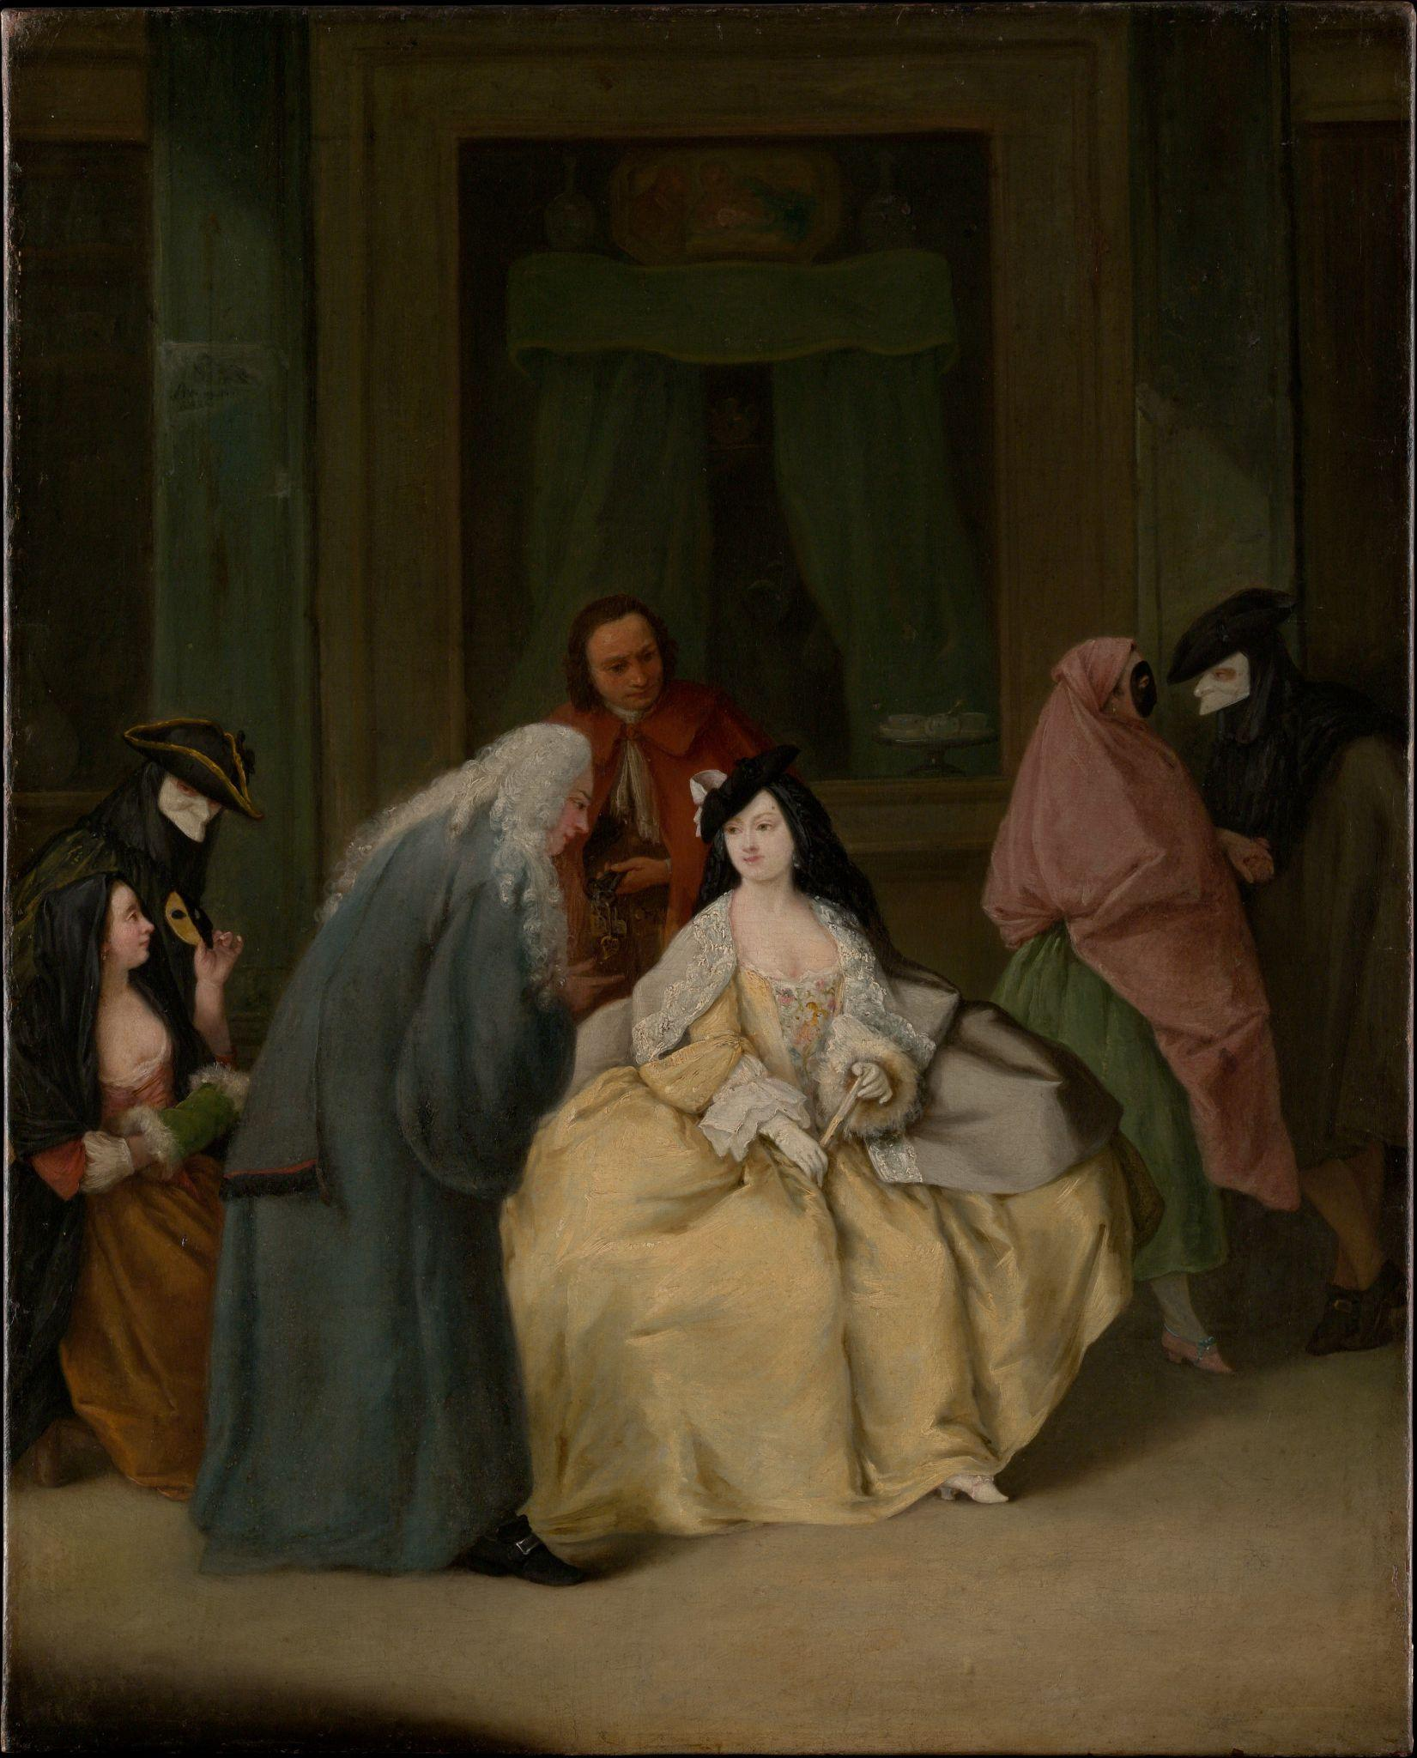
Thanks!
Do you have any questions?
FEEL FREE TO ASK!
Please keep this slide for attribution

Slide 15



Resources
Britannica. “Code of Hammurabi | Summary & History.” Encyclopædia Britannica, 6 Dec. 2018,www.britannica.com/topic/Code-of-Hammurabi.
---. “Grand Canal | Canal, China | Britannica.” Encyclopædia Britannica, 2019, www.britannica.com/topic/Grand-Canal-China.
“ICID: Resources - Irrigation History.” Www.icid.org, www.icid.org/res_irrigation.html.
Encyclopedia Britannica. “Mongol Empire | Facts, History, & Map.” Encyclopædia Britannica, 2 Oct. 2018, www.britannica.com/place/Mongol-empire
“Empires That Have Been Affected by Innovation and Technology.” Encyclopaedia Britannica, Encyclopaedia Britannica, Inc., https://www.britannica.com/search?query=Empires+that+have+been+affected+by++innovation+and+technology..

